Slide 1

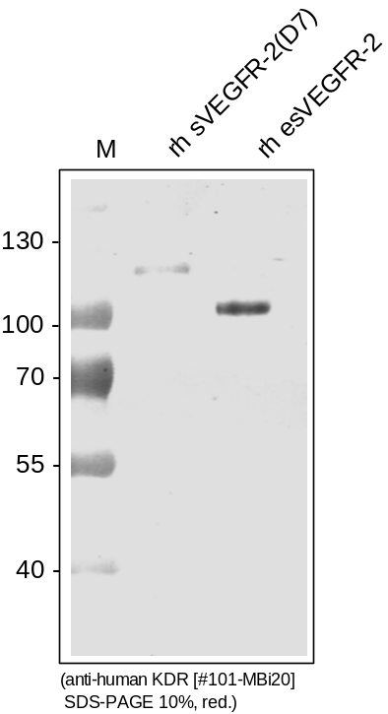
ReliaTech GmbH
Mouse anti-human VEGFR-2/KDR
(Cat #101-MBi20)
Figure 1. Western analysis of recombinant human sKDR(D7) [Cat# S01-002] and recombinant endogenous sKDR [Cat# S01-004] using a Biotin-conjugated monoclonal anti-human VEGFR-2/KDR antibody [Cat# 101-MBi20].
http://www.reliatech.de / orders@reliatech.de

